Slide 1
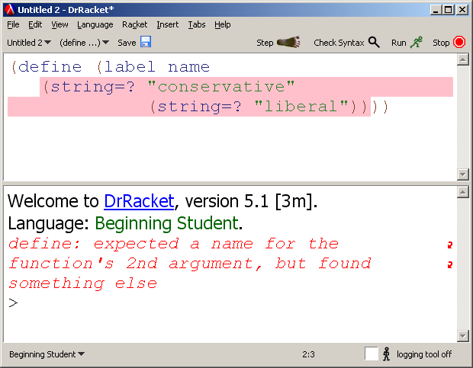
Improving Error Messages
Current messages highlight a fragment related to a textual description …
What the highlight references isn’t always clear to a novice: is “function” here label or string=?

Slide 2
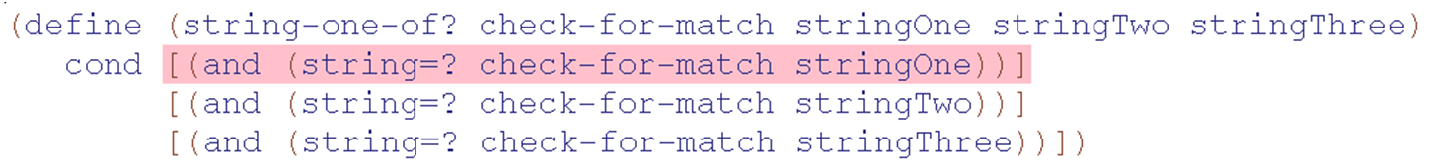
define: expected only one expression for the function body, but found at least one extra part
Problem here is missing ( before cond, but highlight can suggest “edit here”
Goal: improve the wording and GUI for error messages

Slide 3
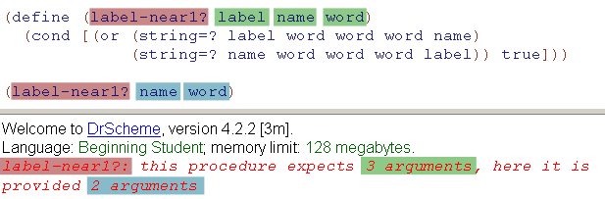
Proposal: Multi-colored highlights
Highlight each definite noun to clarify how text relates to the code
Want to do studies with real users on the impact of this

Slide 4
Readings
Measuring the Effectiveness of Error Messages Designed for Novice Programmers. Guillaume Marceau, Kathi Fisler, Shriram Krishnamurthi. ACM SIGCSE 2011
Mind Your Language: On Novices' Interactions with Error Messages. Guillaume Marceau, Kathi Fisler, and Shriram Krishnamurthi. OOPSLA Onward 2011
Design specification in GitHub/designdocs/errors

